Slide 1

Nisum, Inc
        Date : 01/11/2017
        Presentation : Java 8 Features
        Presenter : Mahesh Bheemanapalli
Notes:
What is a Project Management Review?
A Project Management Review is an exercise undertaken at the end of each Project Phase to identify the current status of the project. The Project Review identifies the deliverables which have been produced to date and determines whether or not the project has met the objectives set. The outcome of the Project Management Review is documented on a project Phase Review Form and this states whether the project is currently on track, within schedule and under budget.
When do I conduct a Project Management Review?
At the end of each Project Phase, a Project Management Review is conducted. Once the Project Review form has been completed, the form is presented to the Sponsor who decides whether to proceed to the next Project Phase.

Slide 2


Java 8 Features :-
        Lambda Expressions
        Method references
        Functional interfaces
        Stream API
        Default methods in interface
        Static method in interface
        ForEach() method
        Base64 Encode Decode
        Optional class
        Collectors class

Slide 3
        Parallel array sorting
        Nashorn JavaScript Engine
        Type and Repating Annotations
        IO Enhancements
        Concurrency Enhancements
        JDBC Enhancements etc
        Local Date-Time API

Slide 4
Oracle released a new version of Java as Java 8 in March 18, 2014. It was a revolutionary release of the Java for software development platform. It includes various upgrades to the Java programming, JVM, Tools and libraries.
        1. Lambda Expressions
        (i). Why Lambdas ?
        It Enables functional Programming.
        Readable and concise code.
        Eliminates Boilerplate code.
        Easier-to-use APIs and libraries.
        Enables support for parallel processing.
(ii).Functional vs Object oriented Programming
As we known Java is a object oriented programming language, so what is the use of functional programming in java ?
Actually Code in OOP:-
        Everything is an object
        All code blocks are associated with classes and objects. Cond…

Slide 5
Suppose if we want to create a simple hello world program? Then what we do ?
Example :-
public class Greeter{
public void greet(){
System.out.println(“Hello World !”);
}
public static void main(String [] a) {
Greeter greeter=new Greeter();
greeter.greet();
}
}

Slide 6
Why spring is called as light weight :
To execute most of the spring apps does not need the heavy weight 3rd party provided containers
The basic jdk s/w along with spring jar files is enough to execute the spring apps.
The spring f/w supplied its own container in the form of set of predefined classes.
what is container:- It is s/w or s/w app or class or object.
contain s/w will manage program life cycle (from birth to death of the program).
Example: servlet container will manage servlet program life cycle.
ejb container will manage ejb prog life cycle.
like spring container will manage spring bean life cycle.

Slide 7
Dependent Injection :
The process of injecting (pushing) the dependencies into an object(dependent object) is known as dependency injection.
By it provide more flexibility/dynamic polymorphism and loosely-coupling
Advantage of dependency injection:--
It provide the loosely coupling.
If the degree of the dependency is the less between two components are called loose-coupling
Ex: GSM mobile
If the degree of the the dependency is high between the two components then that components are called tight-coupled components.
Ex: CDMA mobile.

Slide 8
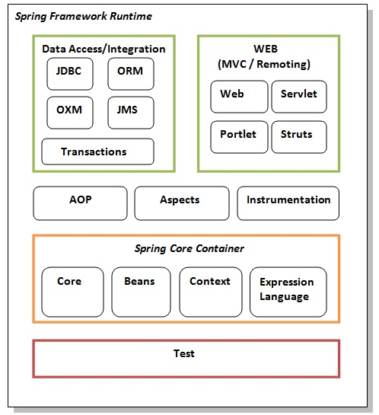
spring architecture
Spring is well organized architectures 1.x is consist of 7 modules.
1. core 2.dao 3.orm 4.aop 5.context 6.web 7 web mvc.

Slide 9
Spring Container
Spring has two types container they are
1.beanFactory container(I) super interface.->core
2.ApplicationContext container(I) child interface-->j2ee
3.ConfigurableApplicationcontext(I)
In spring the dependency injection in generally archived in 3 ways.
Setter injection
Constructor injection
Interface injection

Slide 10
If dependency is provided to dependent obj via setter method is known as setter injections.
If dependency is provided to dependent via constructor is know as constructor injection.
If dependency is provided to dependent object via xxx aware interface method is know as interface injection.
How to implements setter injections:---
Step 1:- in spring bean class declare the required variables(dependencies)
Step 2:- define setter and getter methods for that variables.
Step 3:- use <property> tag in bean configuration file and supply the values.

Slide 11
Spring configuration file
Spring configuration contains bean definitions or configuration and other information.
We can maintain this file with any name.
In spring config file bean config are related to dependency injections.
The <beans> tag is a root tag it extends all the spring bean definitions.
Id:- this attribute is used to hold the object reference.
Class :- attribute is used to specify the spring bean class name.

Slide 12
Client programmer:--
Step 1: activate spring container
String path=””;
FileSystemResource res=new FileSystemResource(path);
xmlBeanFactory factory=new xmlBeanfactory(res);
step 2:- get the bean object from container memory.
To get the bean object from container we can call getBean() method.
Syntax:-
Object obj=factory.getBean(“studentobj”);
Student s=(Student)obj;
Step 3: call the business methods as per the app requirements.

Slide 13
BeanFactory(I):-
It is an interface available in org.springframework.beans.factory package
It is a spring core container
It is implements xmlBeanFactory
When beanFactory container is activated it does not create any spring bean class obj.
It creates the spring bean class objects and completes the dependency injection only when the getBean() is called.
Spring container can perform dependency injection only on those spring bean obj, that are created by spring container it self.
Note:--- to activate bean factory container we can create an object of xml bean factory class.

Slide 14
They are two techniques two frame the rules that are required to constructor xml document dtd,xsd
Every xml file contains are either dtd or xsd
Spring configuration file can be developed either based on dtd rules or based on xsd rules.
In the spring cfg file we can write the following dtd.
This must copy
from org/spfw/beans/factory/xml/sp-beans=2.0.dtd line 36 and 37
To get the above file we can extract spring-beans.jar file.
Note::--
When beanFactory container is activated it reads and verifies the entries of spring configurations file.
The spring beanfactory container internally used sax parser of xml to read and process the spring configuration file entries.

Slide 15
Required jars:-
Spring-core3.0.1
Spring-bean3.0.1
Commons-logging1.2
Constructor injection:--
In spring bean class declare dependency variable as per the requirements.
Define constructor which will take that variable as parameter.
Use <constructor-arg> tag in bean configuration file and supply the values.

Slide 16
Application Context(I):--
It is an enhanced for bean factory
It is a child interface of bean factory
It is present in org.springframework.context. package
It is originally part of the spring context/spring j2ee module.
Key points:-
It loads spring beans configuration in spring configuration file and manges the life cylcle of the spring bean and when container starts.
It won’t wait until getBean() is called
It is ability to work with properties files.
It is support to work I18N
Ability to work with event listeners etc.

Slide 17
They are 3 important implementations for ApplicationContext interface.
1)FileSystemXmlApplicationContext©(org.springframework.context.support).
It activate application context container by locating spring config file for the specified path of the file system.
It is never recommended because if you change project work space again change client program.
Examples:
Spring configFile=”E://spring/core/app/com/nit/config/mybean.xml”;
FileSystemXmlApplicationContext context=new FileSystemXmlApplicationContext(configFile);

Slide 18
2)ClassPathXmlApplicationContext©(org.springframe.context.support)
It activate app context container by using config file from class path environment variable.
It is recommended.
Example:
Spring configFile=”com/nit/config/mybean.xml”;
ClassPathXmlApplicationContext context=new ClassPathXmlApplicationContext(configFile);
3)XmlWebApplicationContext:
(org.sringframework.web.context.support)
It is activated application context container by using spring config file in web apps.

Slide 19
Order details in Fedfil
Required jars:-—
total 6 jar are required to work with application context
they are
1.commons-loggin,2.spring-core
3.spring-bean,4. spring-asm
5.spring-context
6.spring-expression
To perform autowiring for particular bean we can use any one of the following values for autowire attribute
By Name
By type
Constructor
Autodetect

Slide 20


Slide 21


